Slide 1

MIS 281N
Data Management
Class 3 – Designing a Database
Brad Poynter
Clint Tuttle

Slide 2
Goals for tonight
1st part:
Questions
DDL with Insert, Update, Delete, Sequences (~45 minutes)
Debrief starting at 4:45pm
Short Break
2nd part:
DML basics (SELECT, FROM, WHERE, ORDER BY)
Debrief starting at 5:30

Slide 3
SELECT [i.e. column filter]

Slide 4
What are 4 main parts of a SELECT statement?
SELECT
FROM
WHERE
ORDER BY
Knowledge Check
What determines the table(s) we are extracting?
How do you filter records?
How do you select specific columns from a table?
How do you sort records?
SELECT column_list
FROM table_source [WHERE filter_condition] [ORDER BY order_by_list]

Slide 5
SELECT syntax
SELECT column_list
FROM table_source [WHERE filter_condition] [ORDER BY order_by_list]
e.g. SELECT all columns
SELECT *
FROM invoices
e.g. SELECT particular columns
SELECT invoice_number, invoice_date
FROM invoices
e.g. Sort with ORDER BY clause
SELECT invoice_number, invoice_date
FROM invoices
ORDER by invoice_date [DESC]
e.g. Select with WHERE clause
SELECT invoice_number, invoice_date
FROM invoices
WHERE invoice_date = ’02-MAY-2014’

Slide 6
Ways to specify columns in a query’s SELECT clause
All columns in base table
Column name in base table
String Expression
Use the string operator || to concatenate column or literal strings together
Literal strings are defined by you like the following:
Select city || ‘,’ || state or Select ‘Mr. or Mrs.’ || last_name
Arithmetic Expression
Use +, -, /, * to do arithmetic calcs on numeric columns
e.g. Select invoice_total – payment_total
Alias – give custom column names for calculated columns
e.g. Select (invoice_total – payment_total) as “Amount_Owed”
NOTE: Include Quotes (not ticks) around column alias if your column name has spaces are includes spaces. Good rule of thumb is to always use AS w/ no spaces

Slide 7
Practice String/Numeric Expressions & Column Alias:
Select all vendors from NY but concatenate Address into this format: Address; City, State Zip Don’t include alias this time
Add a column alias to this newly created column called “Vendor Address”
Pull vendor_id, invoice total, payment total, and difference of invoice_total & payment_total. Rename calculate calculated to “Amount Owed”
String expression to derive full name
SELECT first_name || ' ' || last_name
String expression to derive full name w/ alias
SELECT first_name || ' ' || last_name as “Full Name”
Arithmetic expression to calculate a value
SELECT invoice_number, invoice_total – payment_total - credit_total
FROM invoices

Slide 8
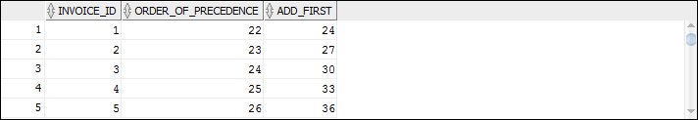
Order of operations apples (PEMDAS)

Slide 9
Scalar functions
Scalar = Operates on a single value and returns a single value
SYSDATE – returns today’s date/time. Like NOW() function in Excel
ROUND – round decimals to whole numbers
SUBSTR – Returns certain part of a string. Like MID() function in Excel
TO_CHAR – convert number/date to string
TO_DATE – convert string to a date
MOD – returns remainder of division of two numbers

Slide 10



Slide 11
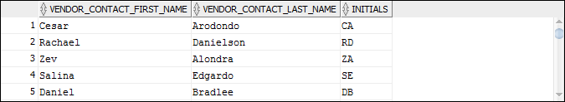

Slide 12
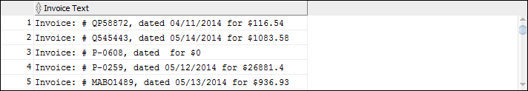

Slide 13


Slide 14
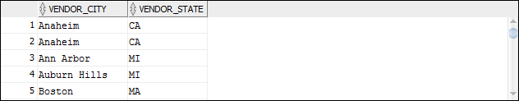
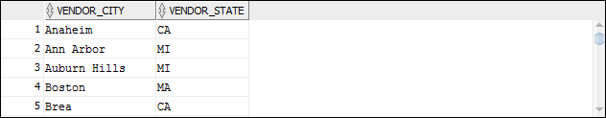

Slide 15
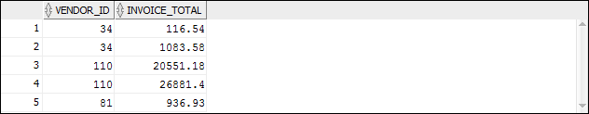

Slide 16
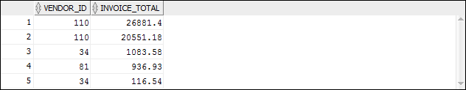
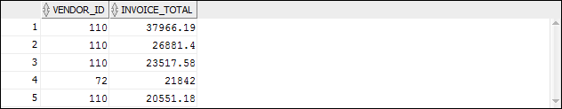

Slide 18
WHERE [i.e. filter rows]

Slide 19
SELECT syntax
SELECT column_list
FROM table_source [WHERE filter_condition] [ORDER BY order_by_list]
[FETCH] --filters after sort
e.g. Select with WHERE clause using a column
SELECT invoice_number, invoice_date
FROM invoices
WHERE invoice_date = ’02-MAY-2014’
e.g. Arithmetic expression in WHERE clause
SELECT invoice_number, (invoice_total – payment_total) As “Money Due”
FROM invoices
WHERE (invoice_total – payment_total) = 0
NOTE: You cannot filter rows using a column alias (do you know why?)

Slide 21
Examples of WHERE clauses that retrieve…
Vendors located in Iowa
WHERE vendor_state = 'IA'
Invoices with a balance due (two variations)
WHERE (invoice_total – payment_total) > 0
WHERE invoice_total > (payment_total + credit_total)
Vendors with names from A to L
WHERE vendor_name < 'M'
Invoices on or before a specified date
WHERE invoice_date <= '31-MAY-14'
Invoices on or after a specified date
WHERE invoice_date >= '01-MAY-14'
Invoices with credits that don’t equal zero
WHERE credit_total <> 0
The syntax of the WHERE clause with comparison operators
WHERE expression_1 operator expression_2
The comparison operators
=
>
<
<=
>=
< >

Slide 22
Other useful keywords to use in a WHERE
NOT
AND, OR
LIKE
IS NULL
IS NOT NULL

Slide 23


The order of precedence for compound conditions
NOT
AND
OR
Tip: Just use parenthesis to be sure

Slide 26
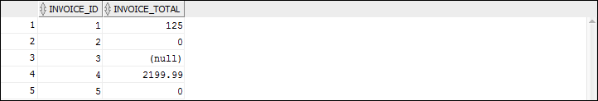

Slide 27
ORDER BY [i.e. sort records]

Slide 28
SELECT syntax
SELECT column_list
FROM table_source [WHERE filter_condition] [ORDER BY order_by_list]
[FETCH] --filters after sort
e.g. Sort with ORDER BY clause
SELECT invoice_number, invoice_date
FROM invoices
ORDER by invoice_date [DESC]

Slide 29

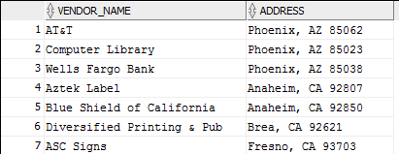

Slide 30
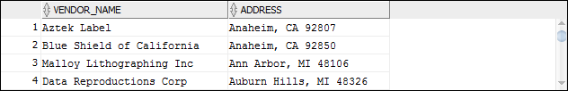

Slide 31
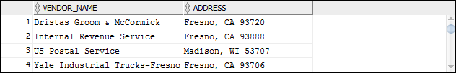

Slide 32


Slide 33
FETCH/OFFSET filtering <after> Order by

Slide 34
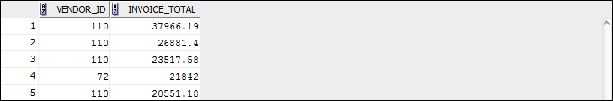

Slide 36


Slide 37
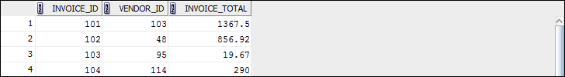

Slide 38
Questions?

